Slide 1
Project Presentation

Slide 2
Team Members
1- Entesar Atef Abd Elrhman Omar
2- Doaa Ahmed Salman
3- Neama Mmdooh Ramadan
4 -Aya Mustafa Kamel
5- Doaa saad Eldeen Yassin

Slide 3
Link Of The Dataset:
https://www.kaggle.com/uciml/breast-cancer-wisconsin-data/version/2

Slide 4
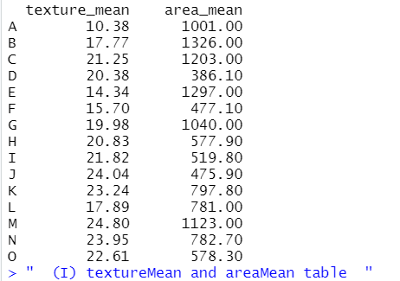
Result Of Visualization Part

Slide 5
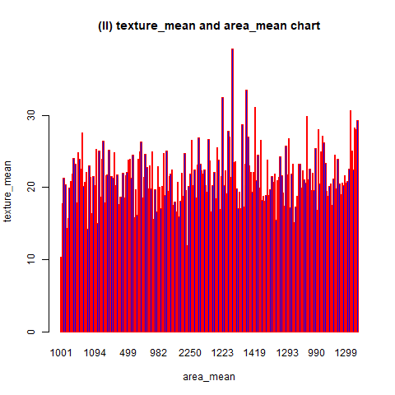

Slide 6
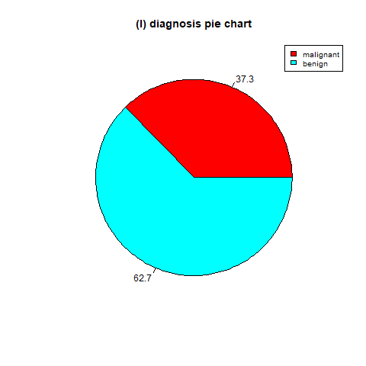

Slide 7
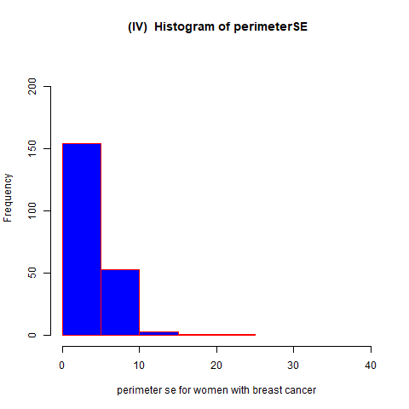

Slide 8
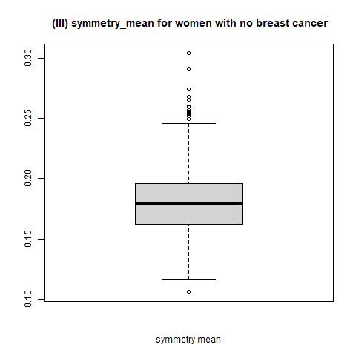

Slide 9
Sparql Quries Part

Slide 10
Semantic Data Integration Phase
We get The All Data From Kaggle Website and we don’t need to integrate or put any data from Us. So We don’t need to put a Semantic Data Integration Phase in our project.

Slide 11
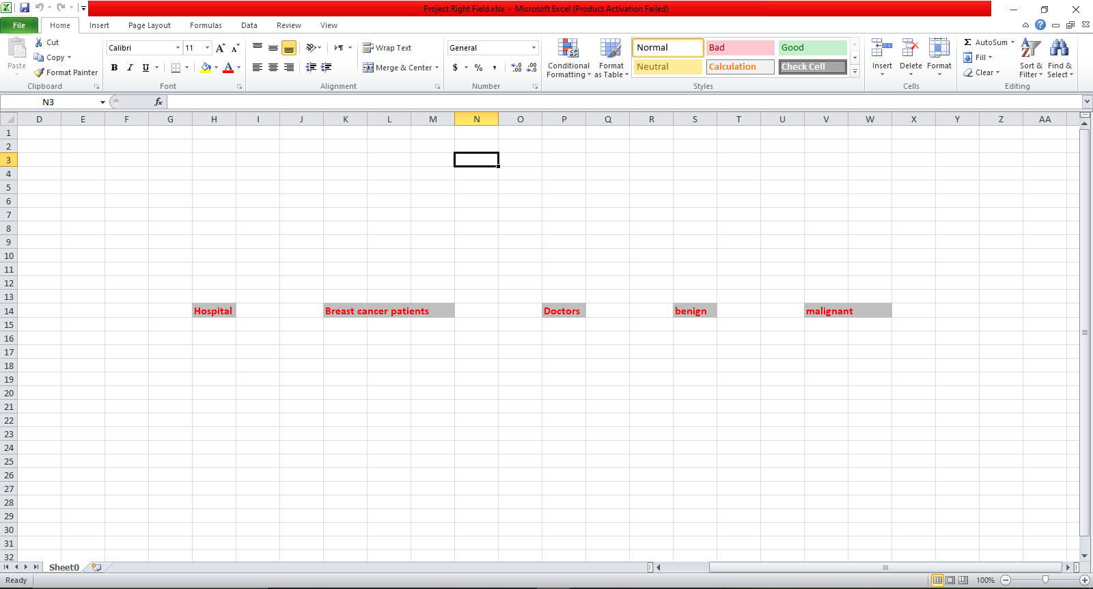
Right Field Part

